Slide 1
Danfoss-Mini TT Shaft Bearing Press
Team 512
November 28, 2023

Slide 2

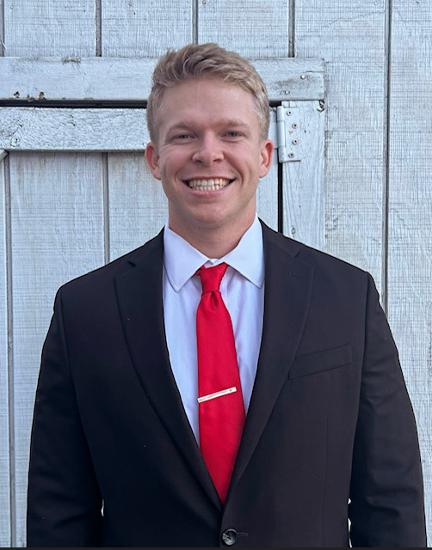
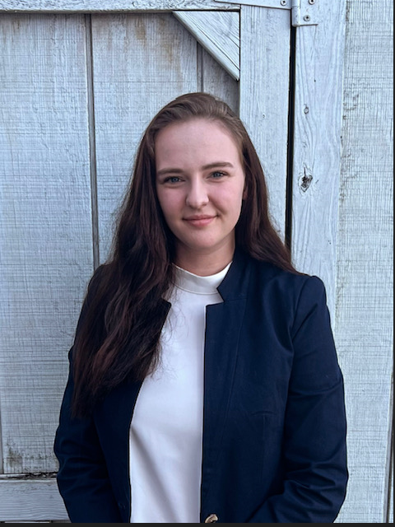
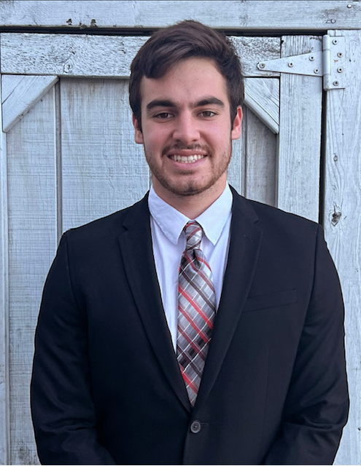
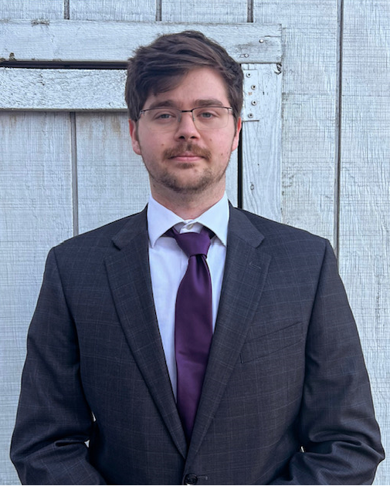
Team Introductions
Clark Cooley
Systems Engineer
Cassie Bentley
Fluids Engineer
Colby Gullo
Safety Engineer
Brent Mynard
CAD Engineer

Slide 3
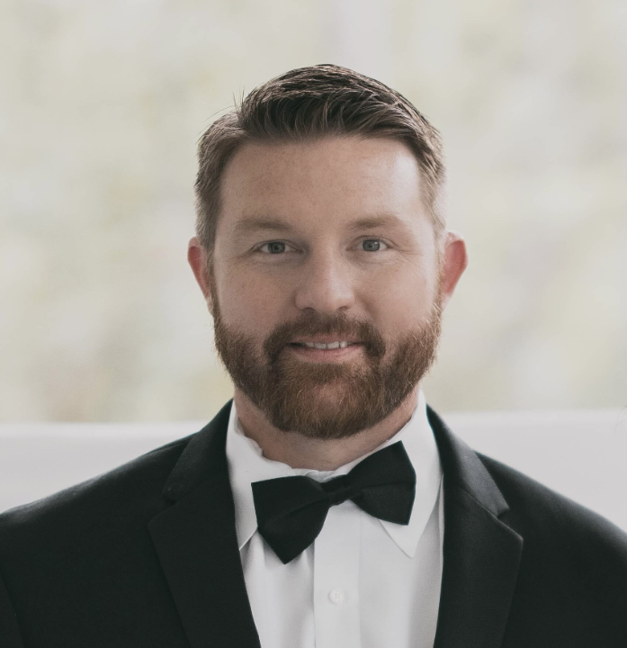
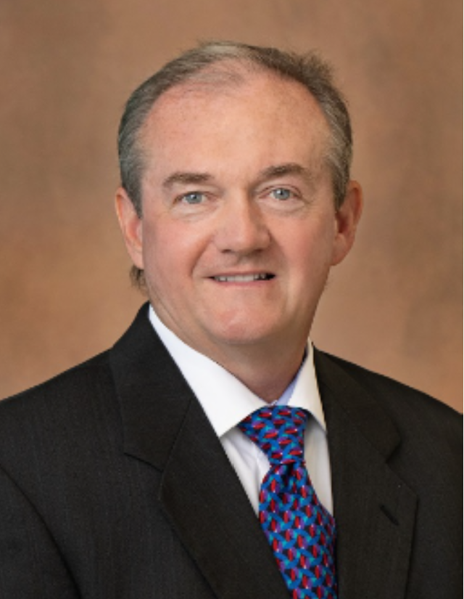
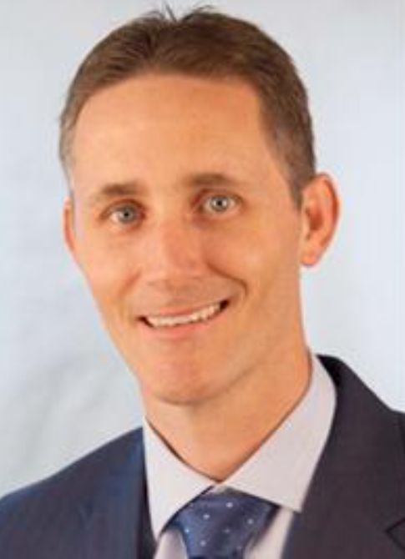
Sponsor and Advisor
Engineering Mentor
Kevin Lohman
Sponsor
Engineering Mentor
William Bilbow
Point of Contact & Sponsor
Academic Advisor
Shayne McConomy
Professor

Slide 4

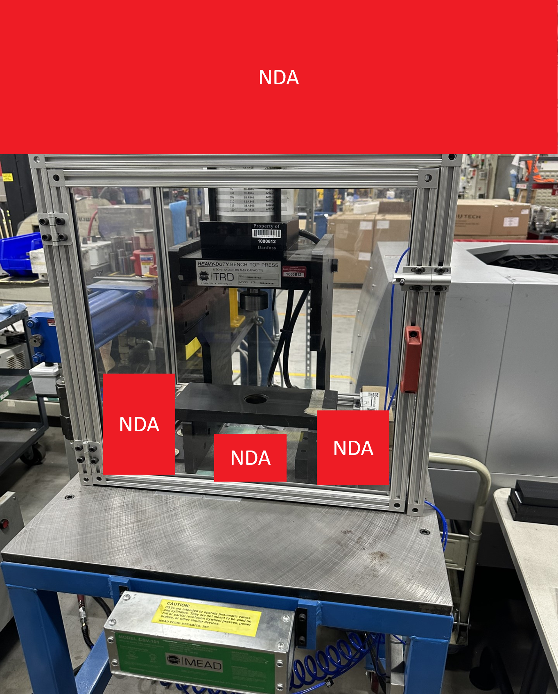
Objective
The objective of this project is to redesign the existing bearing press to press bearings of various sizes onto studs while ensuring ease of manipulation and user safety.

Slide 5
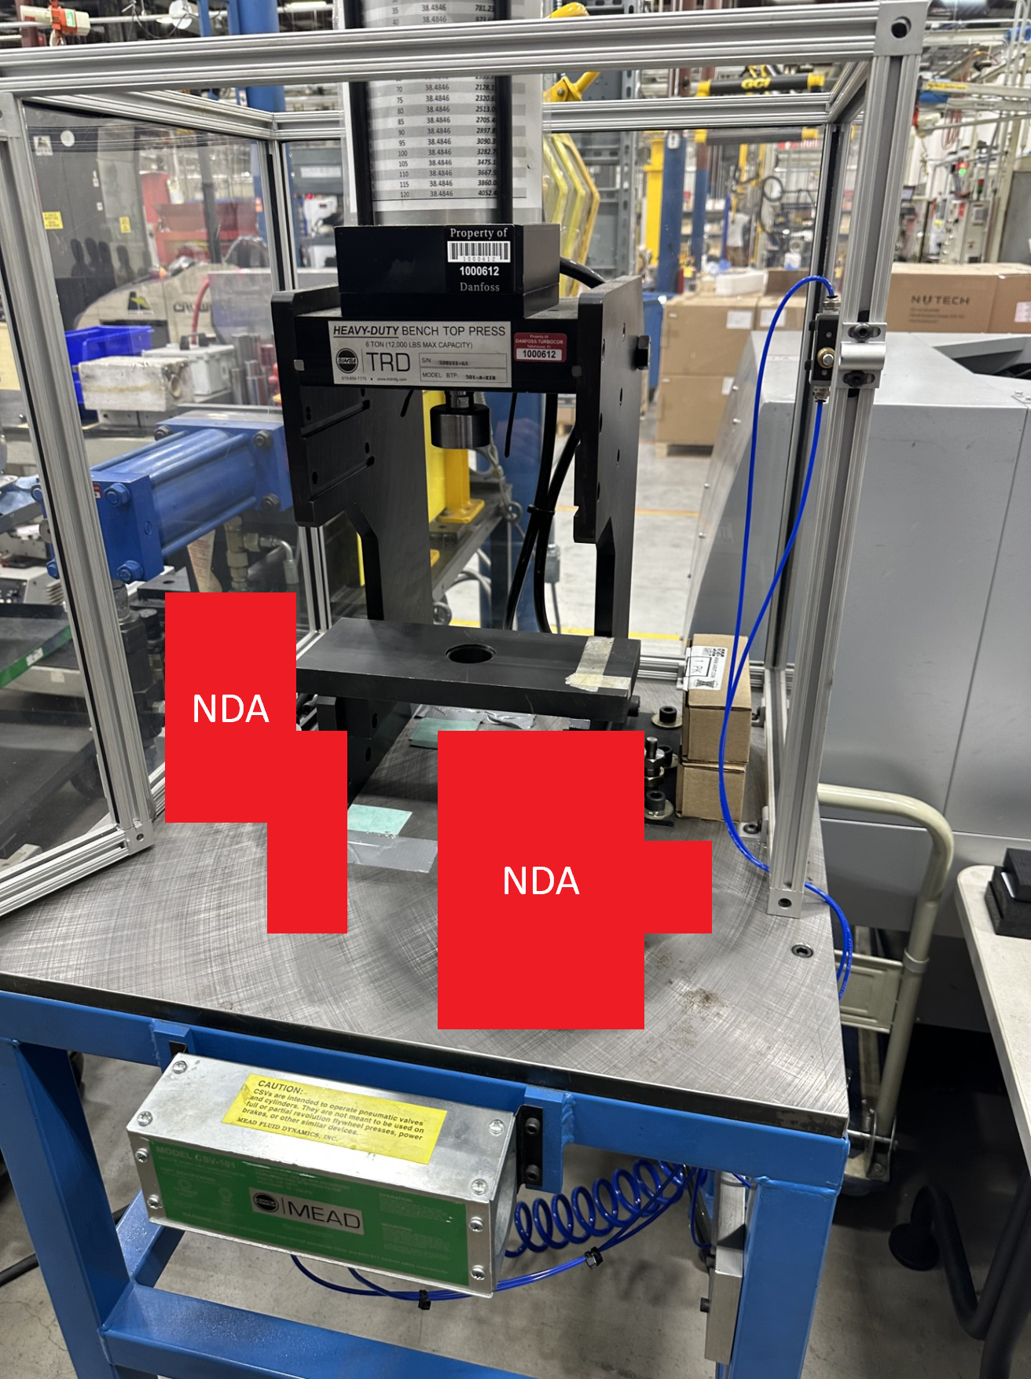
Project Background
Original press created in 2020
Press applies 6 tons of pressure
Bearings are heated to 600 degrees
Shaft is pressed to bearing
Press has two button engagement
Base plate height is fixed​

Slide 6






Key Goals
Modular Baseplate
Press Bearing On Shaft Stud
Ensure Safety Of User
Allow User Ease Of Usage
Optimize Cost

Slide 7
Targets & Metrics
Cassie Bentley

Slide 8
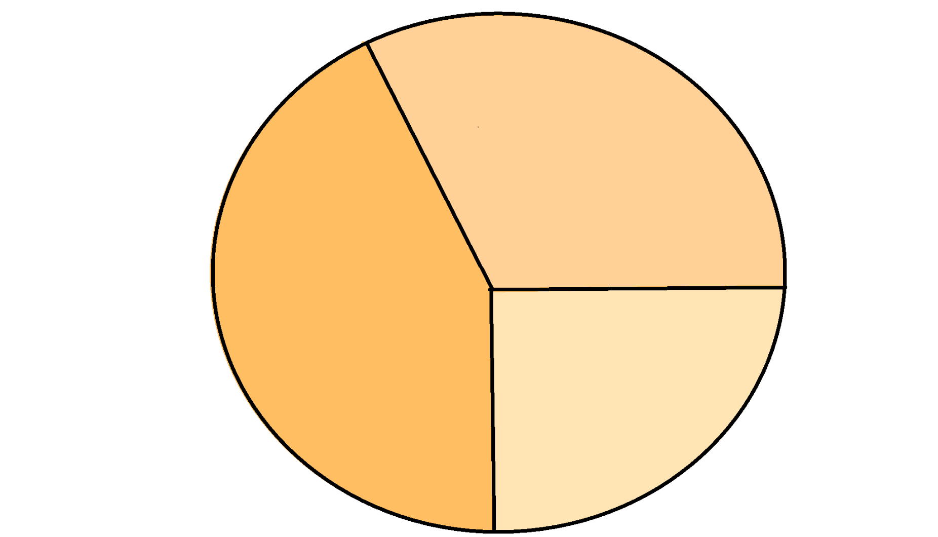
Targets & Metrics
Safety
Interaction
Functionality
Safety
Interaction
Functionality

Slide 9
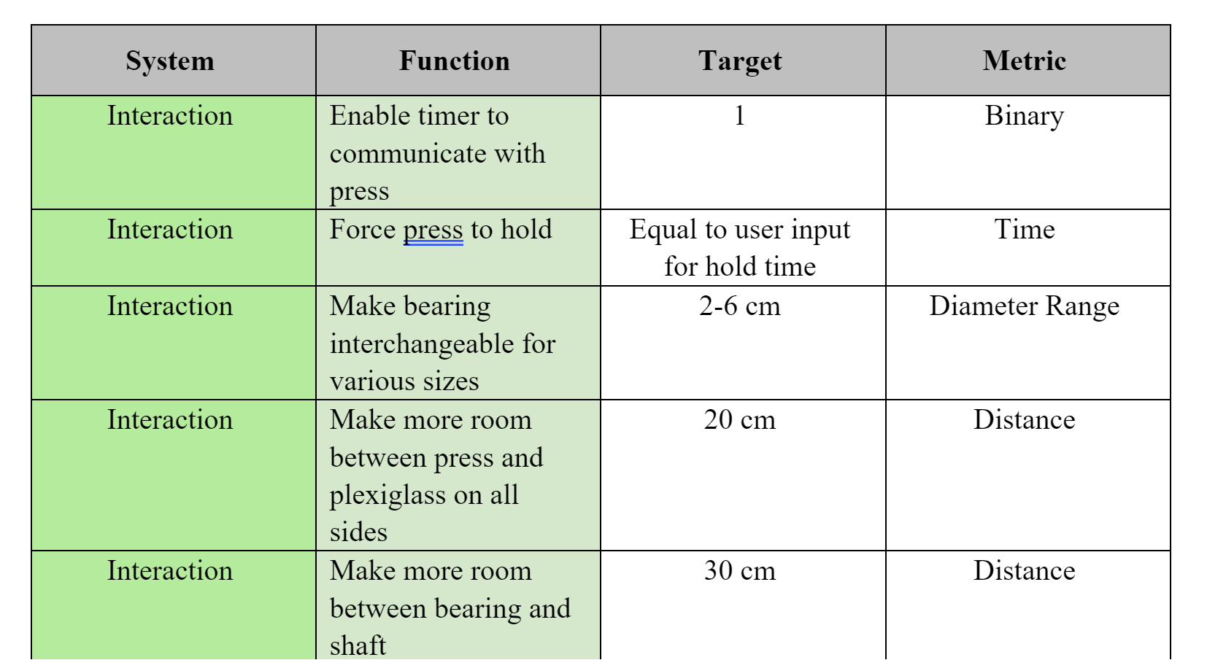
Interaction
Interaction
Interaction

Slide 10
Targets & Metrics
Safety
Interaction
Functionality
Safety
Interaction
Functionality

Slide 11
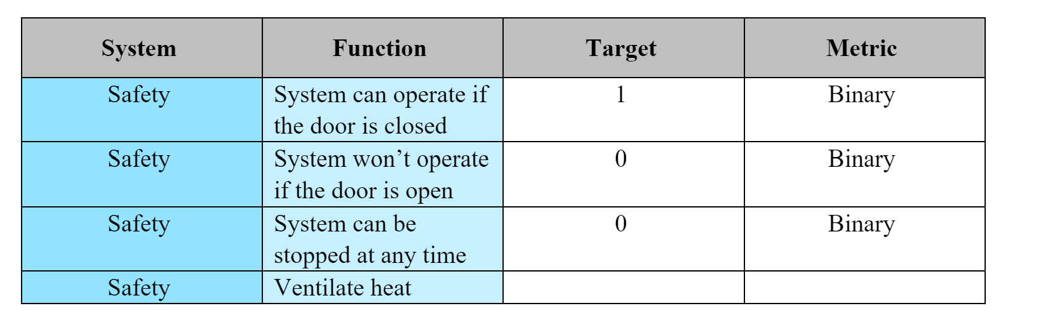
Safety
Safety
Safety

Slide 12
Targets & Metrics
Safety
Interaction
Functionality
Safety
Interaction
Functionality

Slide 13
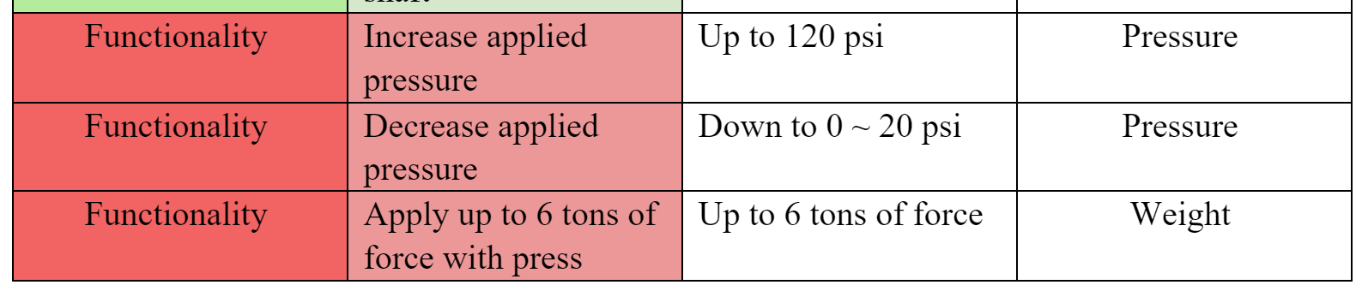
Functionality
Functionality
Functionality

Slide 14


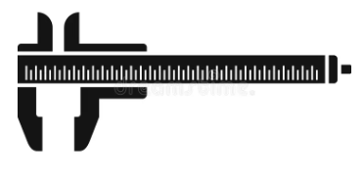



Method of Validation
A variety of tools will be used to examine and verify the system targets.
Ruler
Coding
Software
Caliper
Force Gauge
Financial
Assessment

Slide 15

Concept Generation
For Concept Generation 100 concepts in the generation phase, our team narrowed down the options to five medium-fidelity concepts.
It could have bulletproof glass!
Or it could have a wire cage!
#4
#5

Slide 16



Concept Generation Tools
As a group we wrote on a whiteboard different ideas, then fed off of each others ideas. This made up the majority of our 100 concepts.
Brainstorming
Biomimicry
Crapshoot
Mimosa Pudica retracts its leaves when it feels physical touch. This inspired the concept of having a sensor in the handle that detects when a person touches it and retracts the press
Having a rodent power up the press.

Slide 17
Medium Fidelity Concepts
These medium-fidelity concepts that were chosen because they each demonstrated the capability to address at least one of the project's challenges.
Concept Number | Description
6 | Magnetic Door Lock
11 | Ventilation Fan
24 | Electrical Powered
32 | Adjustable Chuck
26 | Easily Maintainable
Concept #
Medium Fidelity Concepts

Slide 18
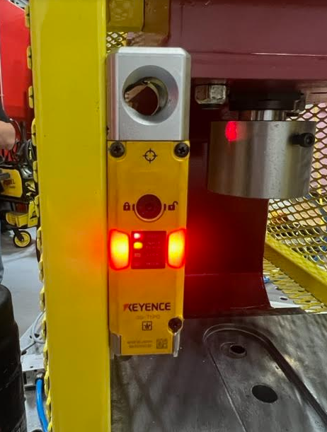
Medium Fidelity Concepts
Concept Number | Description
6 | Magnetic Door Lock
Concept #
Medium Fidelity Concepts

Slide 19
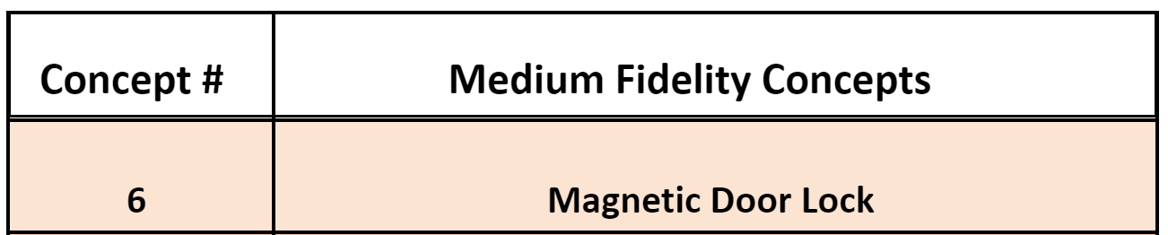
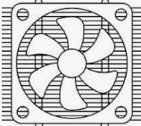
Medium Fidelity Concepts
Challenge: We don’t want the press to overheat.
Preventing Contamination
Cooling
Reducing the Risk of Failure

Slide 20

Medium Fidelity Concepts
Concept Number | Description
24 | Electrical Powered
Concept #
Medium Fidelity Concepts
Challenge: We need to help improve the safety/ automation of the press.
Add Sensors
Hands Free

Slide 21
Medium Fidelity Concepts
Concept Number | Description
32 | Adjustable Chuck
Concept #
Medium Fidelity Concepts
Challenge: We need the press to fit various size shafts.
The existing press is designed to accommodate a single type of shaft secured in place with magnets. Transforming it into an adjustable chuck would enable the press to accommodate shafts of various sizes, expanding its versatility.

Slide 22
Medium Fidelity Concepts
Concept Number | Description
26 | Easily Maintainable
Concept #
Medium Fidelity Concepts
Challenge: Its hard to access the current parts
Easily Removable
Parts Are Accessible Outside Safety Guard
Easy To Clean

Slide 23



High Fidelity Concepts
Concept Number | High Fidelity Concept
1 | Wire Mesh: Cage
28 | Timer/ Emergency Stop
54 | Adjustable Press

Slide 24
Concept Selection
Brent Mynard

Slide 25
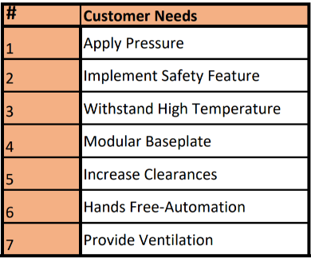
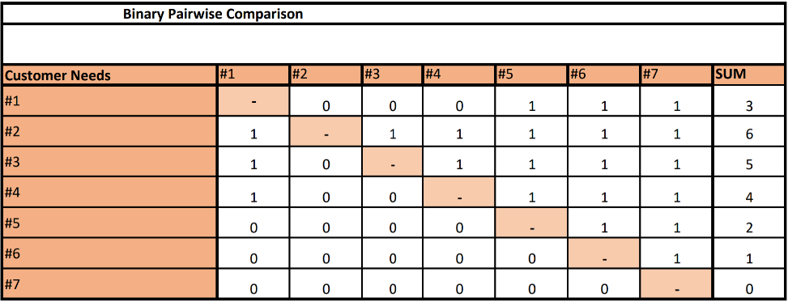
Binary Pairwise
1
Implement Safety
- | 0
1 | -
2
Withstand High Temperature
1
Modular Baseplate

Slide 26
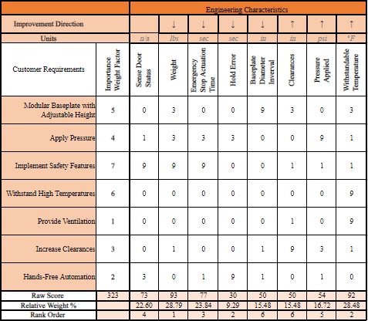
House of Quality

Slide 27
House of Quality
3
2
Hold Error
Emergency Stop Action Time
2
1
Withstandable Temperature
Weight

Slide 28
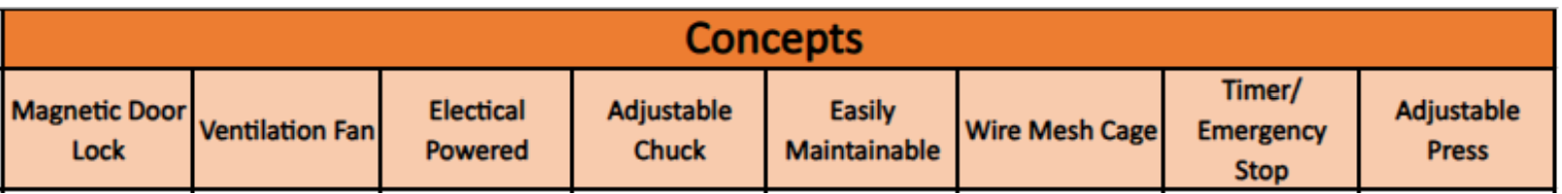
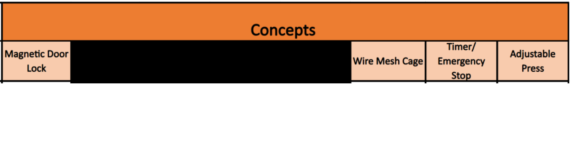
Pugh Charts

Slide 29
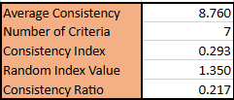
Analytical Hierarchy Process
Target Comparison
Normalized Target Comparison
Consistency Check

Slide 30

Final Selection
Wire Cage
Input Timer /
Emergency Stop
Adjustability

Slide 31

Future Work
Begin Designing The Press In CAD
Meet With Sponsors
For Approval Of New Designs
Risk Assessment
Take Apart Old Press
Brent
31

Slide 32
Thank you

Slide 33
Backup Slides

Slide 34
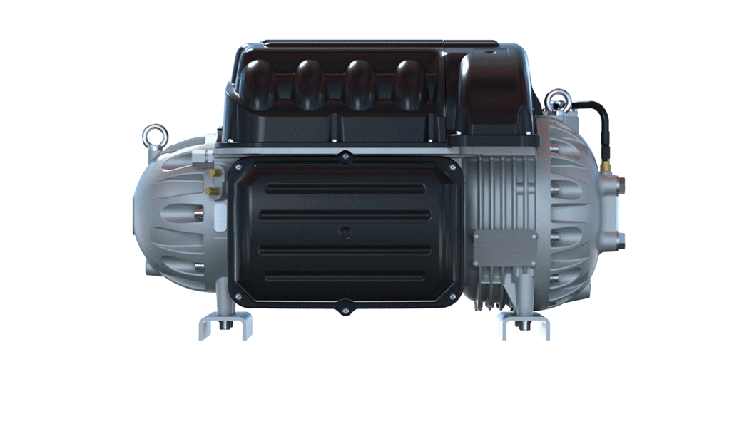
Danfoss Turbocor® TT series
Oil free compressors using HFC134a refrigerant

Slide 35
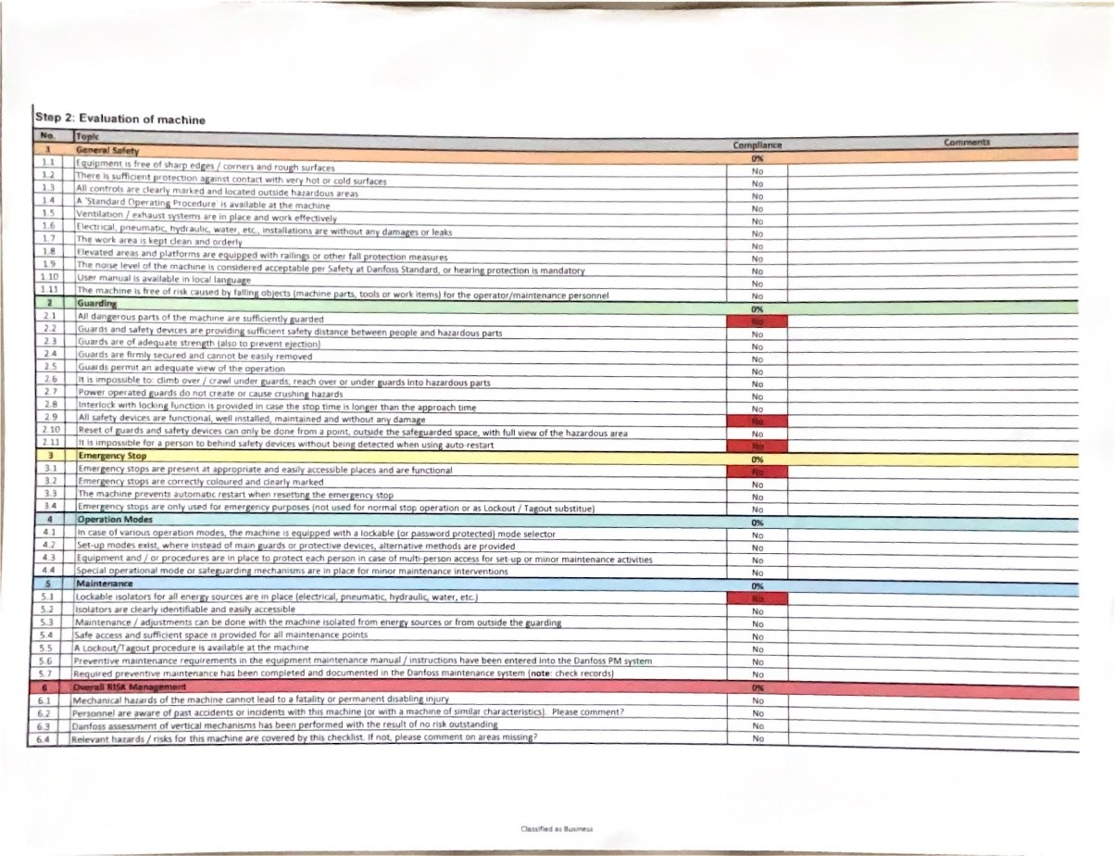
Machine Evaluation Sheet

Slide 36
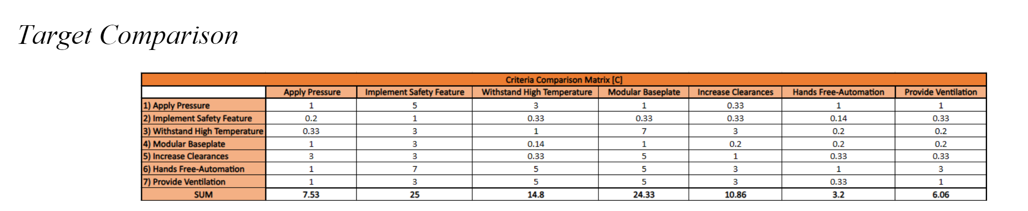
Cross Reference Table

Slide 37
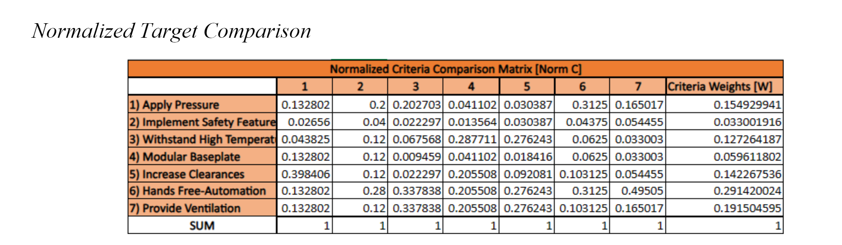
Cross Reference Table

Slide 38
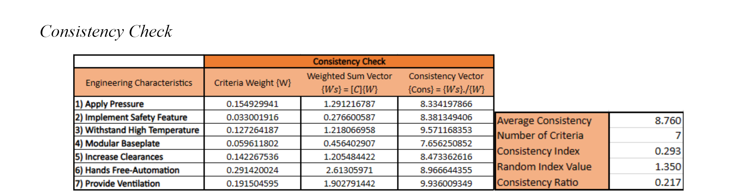
Cross Reference Table

Slide 39
This is 10-point
This is 15–point Times
This is 20–point
This is 25–point
This is 30–point
This is 35–point
This is 40–point
This is 50–point
This is 60–point
This is 72–point
Notes:
Use at least 20-point font in Room A105, B134, and B136
Use at least 25-point font in Room B135

Slide 40
College of Engineering Color Palette
1 2 3 4
Pantone: PMS 195 C
RGB: 120, 47, 64
Hex: #782F40
CMYK:19, 90, 50, 55
1 2 3 4
Pantone: Black C
RGB: 0, 0, 0
Hex: #000000
CMYK:0, 0, 0, 100
Garnet
Black
1 2 3 4
RGB: 238, 118, 36
Hex: #EE7624
CMYK:2, 66, 99, 0
1 2 3 4
Pantone: PMS 000C
RGB: 255, 255, 255
Hex: #FFFFFF
CMYK: 0, 0, 0, 0
Fang
Orange
White
Notes:
Avoid 75% Black in B135

Slide 41
Accent Color Palette
1 2 3 4
RGB: 0, 59, 111
Hex: #003B6F
CMYK:
1 2 3 4
RGB: 0, 59, 111
Hex: #003B6F
CMYK:
1 2 3 4
RGB: 251, 236, 93
Hex: #FBEC5D
CMYK:
1 2 3 4
RGB: 219, 215, 210
Hex: #DBD7D2
CMYK:
1 2 3 4
RGB: 251, 236, 93
Hex: #FBEC5D
CMYK:
1 2 3 4
RGB: 219, 215, 210
Hex: #DBD7D2
CMYK:
Tardis Blue
Tardis Blue
Corn
Timberwolf
Corn
Timberwolf
1 2 3 4
RGB: 206, 0, 88
Hex: #CE0058
CMYK: 0, 100, 43, 12
1 2 3 4
RGB: 206, 0, 88
Hex: #CE0058
CMYK: 0, 100, 43, 12
1 2 3 4
RGB: 104, 40, 96
Hex: #682860
CMYK:
1 2 3 4
RGB: 220, 220, 220
Hex: #DCDCDC
CMYK:
Rubine Red
Rubine Red
Imperial
Gainsboro
1 2 3 4
RGB: 72, 146, 155
Hex: #48929b
CMYK:
1 2 3 4
RGB: 64, 224, 208
Hex: #40E0D0
CMYK:
1 2 3 4
RGB: 255, 139, 0
Hex: #FF8B00
CMYK:
Asagi-iro
Turquoise
American Orange
Notes:
Remove American orange add hyperlink grey
Make corn the last for b135
All work in 134 imperial move later
Tardis doesn’t work in b136

Slide 42
F7AB19
D67F15
EE7624
D64615
F73119
Analogous
https://color.adobe.com/create/color-wheel
6E3610
F0A16C
EE7624
6E4931
BASB1C
Monochromatic
A14508
4BED3B
EE7624
250CED
2010A1
Triad
A1470C
FF8C40
EE7624
0098A1
24E2ED
Complementary
28A164
2FED8D
EE7624
0848A1
1871ED
Split Complementary
EDAC2F
3BED93
EE7624
0C6AED
ED2F18
Double Split Complementary
ED660C
C7ED3B
EE7624
0CE1ED
A418ED
Square
BA7E09
87724A
EE7624
60EFCF
09BA61
Compound
AD551A
6E3610
EE7624
FA7625
D46820
Shades
Notes:
These are the variants that work well with Fang Orange. The bolded items show well on the projectors.

Slide 43
85412D
8F3831
782f40
8F3176
792D85
Analogous
https://color.adobe.com/create/color-wheel
C44D69
8E626D
782F40
C48796
451B25
Monochromatic
C43959
78743B
782F40
236178
43A2C4
Triad
C43959
C46078
782F40
25C43D
2F783A
Complementary
93C460
577835
782F40
39C49D
297861
Split Complementary
784435
5A783B
782F40
237860
6E2978
Double Split Complementary
782337
78683b
782F40
237830
293978
Square
AB4D32
DEBAAF
782F40
5D8555
70AB32
Compound
38161E
C44D69
782F40
853447
5E2532
Shades

Slide 44
A105
A105
B135 Stage Left
B135 Stage Right
B136
B134, A105
B135

